Slide 1
Marriage: A Bond Between 3
God
God binds this man to this woman
God binds this woman to this man
Man
Woman
Man agrees to marry this woman
Woman agrees to marry this man

Slide 2
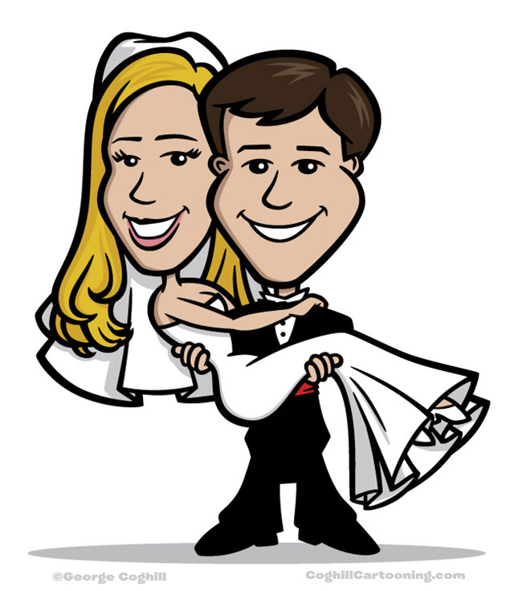
A Successful Marriage is Founded on God
A successful marriage includes these things…
Love
Security
Affection
Happiness
Friendship
which cannot be obtained without practicing these characteristics…
Christian Characteristics
Commitment
Love
Contentment
Obedient
Humility
Selflessness
Patience
Repentance
Forgiving
All because you want to be pleasing to God and you rely on Him.
God

